Slide 1
205 Oct 9, Class 7
Gino & Wiltermuth (2014)
Chapter 7: Within-participant designs
  History effects as an extraneous variable

Slide 2
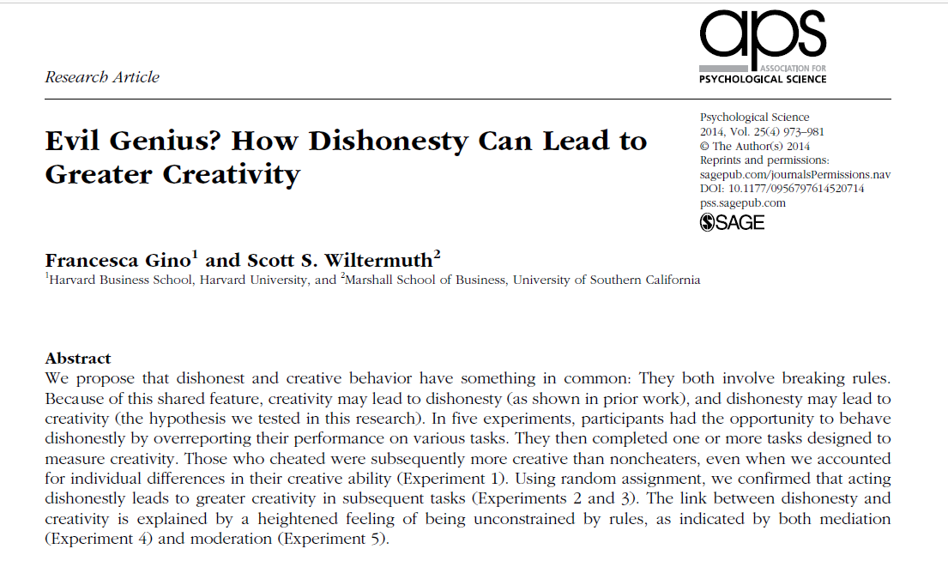

Slide 3
Q1. Across the first three studies, what construct does the independent variable aim to capture?
Q3. What is the common operational definition of creativity used as the dependent variable across the first three experiments?

Slide 4
Operational definitions
Creativity
  Remote Associates Test (RAT)
  What is the common word that links
    Sore, Shoulder, Sweat
    Opera, Hand, Dish
    Piece, Mind, Dating
Dishonesty
  Experimentally controllable (or measurable) cheating or lying

Slide 5
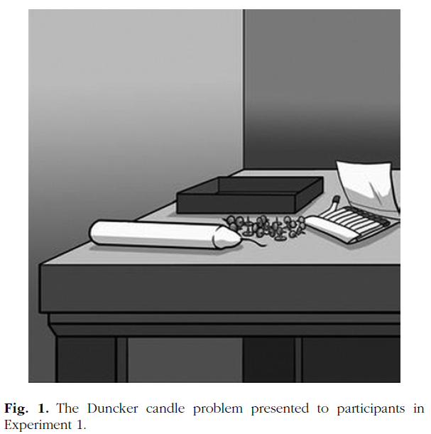
Experiment 1
Procedure
  Dunker candle problem
  Filler/cheatable task
    10 matrices
    Self-reported performance, paid
  RAT performance
Results
  Cheaters performed better on the RAT test
  No random assignment to the cheating condition here

Slide 6
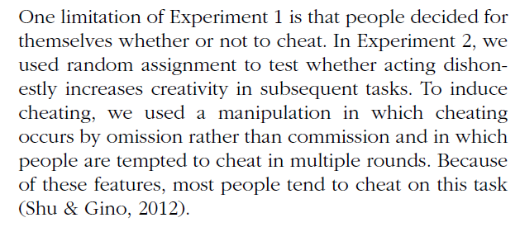
Experiment 2
How do you experimentally control cheating to be able to randomly assign participants to the “cheating” and control conditions?
  Operational definition of this IV

Slide 7
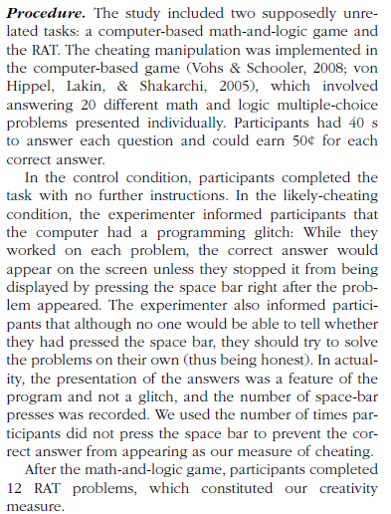
IV
DV

Slide 8
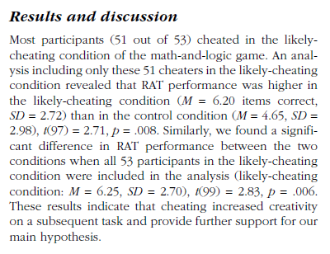
Effect size:
  6.20 vs 4.65 problems solved
  = 1.55 more
2 independent samples t-test

Slide 9
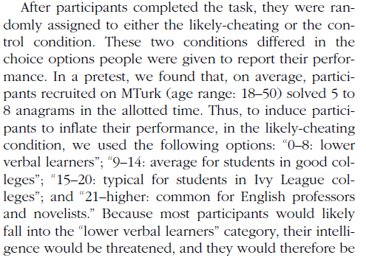
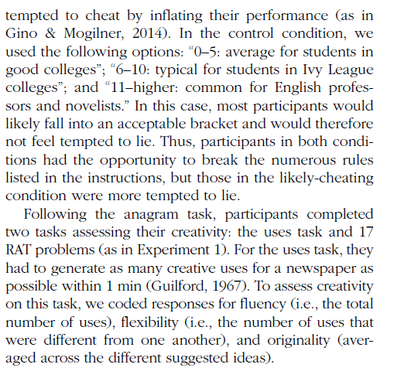
Gino & Wiltermuth (2014)
In Experiment 3, what is the IV changed to and why?

Slide 10
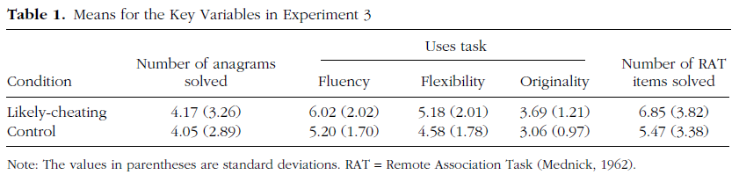
Exp 3 Results
Alternate hypothesis for Exp 3?
Ethical questions about this research?

Slide 11
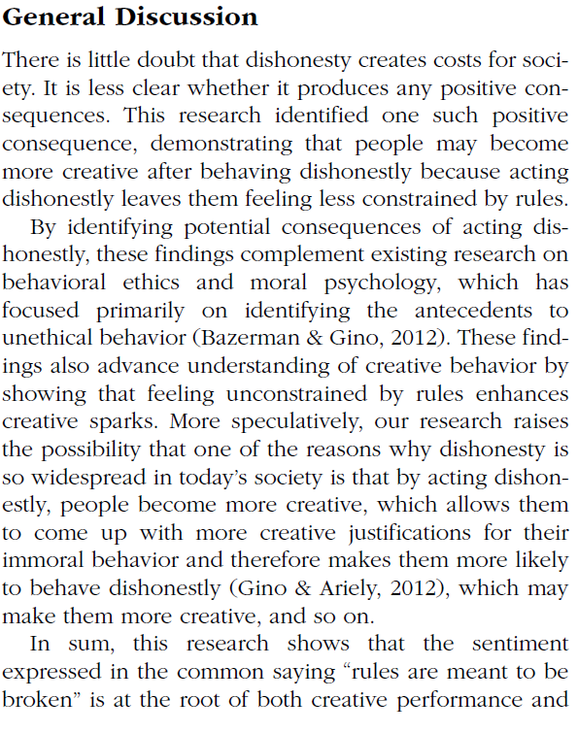

Conclusions
From the General Discussion, how do the authors explain the overall set of their findings with respect to the theoretical relationship between dishonesty and creativity via a mechanism? Give an example of a speculative point made that goes beyond the statement of results.

Slide 12
In an effort to determine the effects of the drug chlorpromazine on the cognitive performance of schizophrenics, two clinical investigators randomly selected 20 acute schizophrenics from a mental hospital population.
The patients were asked to order several stimuli along some dimension, such as ordering eight stimuli by weight.
There were several tasks of this sort.
The investigators used a within-participant design in which all participants first performed the tasks after being injected with a saline solution (placebo) and then performed the tasks again several hours later after being injected with chlorpromazine.
The results indicated that fewer errors were made in the chlorpromazine treatment, which suggested to the investigators that the drug facilitates more adequate cognitive functioning in this type of patient.

Slide 13
Jones wondered if infants might begin the social control of facial expressions, including smiles even earlier than 18m. A laboratory testing situation was set up to observe 10m-old babies with their mothers. Two conditions were tested. In one, the mother paid attention to the baby for 6 min; in the other she read a magazine for 6 min. The baby was videotaped and smiles were later scored by judges who viewed the tapes. Babies smiled at their mothers more often when their mothers were attentive.

Slide 14
 | Mom watching | Mom reading
SN | 12 | 6
JF | 8 | 7
KM | 4 | 3
GB | 2 | 0
SB | 18 | 15
Avg | 8.8 (2.9) | 6.2 (2.5)

Slide 15
Smiling
Two-sample t-test assuming equal variances, t(8)=0.69, p>0.65

Slide 16
Smiling
Paired t-test, t(4)=2.83, p< .05

Slide 17
Within-participants design
Generally better
  Except when it’s not
Advantages
  Highly efficient. Each participant provides data in all conditions so accumulating data collection towards the planned number of participants is more rapid.
  Perfect control of participant variables. Since all participants provided data on all conditions, the conditions are exactly matched for all extraneous variables related to the participants on the task, e.g., motivation, attention, ability.

Slide 18
Within-participant design concerns
History effects: carryover, learning, fatigue
  Counterbalance order across participants
  Be aware when this doesn’t work
    Can require a factorial analysis (Chapters 9-11)
Participants aware of all IV levels
  Might be aware of the experimental hypothesis
  Might therefore be biased in responding

Slide 19
Questions
1. Why is it generally impractical to use a within-participants design in studies that have an element of deception (e.g., the implicit bias studies)?
2. For a study assessing time to recognize famous faces upside-down, why would a within-participants design be a good idea? Give two reasons.
3. Why are mood manipulation studies difficult to do as a within-participants design?

Slide 20
For Fri Oct 9
Chapter 8: Ethics
  Assignment questions
Submit first experiment report by end of day
Monday 10/14: First Midterm
  Prior exams are posted to Canvas as study aids

Slide 21
APA Report Sections
Abstract
  Very concise summary, ~200 words
Introduction
  Construct, background, hypothesis
Methods
  Participants, materials, procedure
Results
  Figure
Discussion
  Conclusion, interpretation, limitations
References

Slide 22
APA Format: Methods
Which of the following is the main goal of the methods section of a research report?
  a. Meticulously articulate how you analyzed the data.
  b. Provide enough detail to allow an independent researcher to replicate your study.
  c. Outline the demographic information of your participants so that reviewers can access the generalizability of your research.
  d. Discuss the procedure you used so that readers can decide for themselves if your protocol is biased.

Slide 23
APA Format: Results
Which of the following is usually beyond the scope of the results section of a quantitative research report?
  a. Discussing what statistical techniques were used
  b. Presenting figures and/or tables to portray the data
  c. Providing detailed interpretation of the implications based on the data
  d. Presenting specific statistics that were generated from the data

Slide 24
APA Format: Discussion
If you state alternative explanations in your discussion, which of the following should you also consider doing?
  a. Tell readers why the alternative explanation falls short of the primary explanation
  b. Conduct statistics tests to test them specifically
  c. Include reviewer opinions of whether they think the alternative explanation is better or worse than the primary explanation
  d. Present a literature review that would allow readers to conduct a follow-up study based on the alternative explanation

Slide 25
APA Writing with Style
What is the role played by answering the question “who will you write for” in writing a research report? How should the answer influence the writing process?
Citing previous research
  Craik & Tulving (1972) proposed that better memory would research from more semantic engagement with the material being studied and termed this “deeper” processing.

Slide 26
Background literature
APA format for the References section
  Craik, F. I. M., & Lockhart, R. S. (1972). Levels of processing: A framework for memory research. Journal of verbal learning and verbal behavior, 11(6), 671-684.
  Craik, F. I. M., & Tulving, E. (1975). Depth of processing and the retention of words in episodic memory. Journal of experimental Psychology: general, 104(3), 268.
Notes:
Demonstrate use of google scholar

Slide 27
Theory: “Deep” Encoding
Hypothesis
  What is it?
  What isn’t it?
Mechanism
  Inferred
Specific Procedures
  Used in studies to test
  Combination of testing operational definitions and underlying theory
  What if our study hadn’t worked?

Slide 28
Research Context
Building on existing work
  Strengthens confidence in conclusions
  Very briefly review theory/mechanism
Adding something new
  What is new about our study?
  Motivate the current study to add to prior work

Slide 29
Experiment 1 Methods information
Participants
  38 students from Research Methods classes
Materials
  A set of 60 words was used for the study and test stimuli. Words were selected to have a written frequency of 30-80 per million and to be 5-8 letters in length.
Procedure
  4s time per word to rate (automatic advance)
    “For each word, rate how much you like the word on a 1 to 5 scale. 5 means you like the word very much and 1 means you dislike the word very much. Indicate your rating with keyboard or mouse.”
    “For each word, count the number of vowels in each word. Enter the number with keyboard or mouse"
  3m delay period completing trivia questions
  60 item post-test, 30 old, 30 new

Slide 30
Results
Include all of:
  Descriptive statistics: mean, SD, SE
  Inferential statistics: t-test in APA format
  Figure & caption
As discussed in class, will be very compact

Slide 31
First writeup
Include title page, abstract
Introduction: 1-2 paragraphs citing prior work, noting what is new about this study
Methods: full detail
Results: full detail including Figure and caption
Discussion: 1-2 paragraphs summarizing conclusion, note limitations
  Finish on strong positive statement!
References:

